Slide 1
Educating for Careers 2014
Math Project-Based Learning and the Common Core: Intersection, Union, or Empty Set?
March 4, 2014
Kentaro Iwasaki

Slide 2
Who’s Here?
Raise your hand for all groups that apply to you
Teachers
  Career Technical
  Mathematics
  Other
Pathway Leads
School Administrators
District Administrators
Counselors
Other
Notes:
Pathway themes
Mix of teachers (academic, CTE, School admin, district admin, other)

Slide 3
Who Here Is In a Linked Learning Pathway?
Please raise your hand if you are in a Linked Learning Pathway.
Notes:
Pathway themes
Mix of teachers (academic, CTE, School admin, district admin, other)

Slide 4

Components of Linked Learning
A comprehensive four-year
program of study integrating:
Rigorous academics
Real-world technical skills
Work-based learning
Personalized supports
Notes:
Linked Learning is an approach.
Think of it as an umbrella for a variety of models.
In order to be under the umbrella, those models must have the core components of Linked Learning in place.
You may have heard of career academies, or smaller learning communities, or small themed schools.
They can all be Linked Learning pathways if they have the core components in place.
Core Components of Linked Learning
Rigorous academics. The academic component of Linked Learning includes college preparatory English language arts, mathematics, science, history, and foreign language courses.
Real-world technical skills. A challenging technical component of three or more courses that help students gain the knowledge and skills that can give them a head start on a successful career.
Work-based learning. A series of work-based learning opportunities that begin with mentoring and job shadowing and evolve into intensive internships, school-based enterprises, or virtual apprenticeships.
Personalized supports. Student supports including college and career guidance, academic counseling, and supplemental instruction in reading, writing, and mathematics that help students master the academic and technical learning.

Slide 5

Common Pathway Features
Utilize pathway student learning outcomes
to guide and align assessment, curriculum,
and instruction
Blend academic and career-themed
course content through rigorous and
relevant standards-aligned projects
Students learn in cohorts; teachers use
common planning time
Provide learning beyond the classroom and the school day
Offer dual-enrollment and dual-credit with college institutions
Notes:
Pathway student learning outcomes describe what we want graduates to know and be able to do – in the context of the career theme
Pathways that provide personalized support to integrate academic and technical/professional learning through real world application and
work-based learning, have a better chance of graduating with the knowledge, skills and dispositions necessary for college and career
readiness because they had the opportunity to practice and develop them while in high school.

Slide 6
Session Objectives
Explore the Venn of Common Core Math and Project-Based Learning in a Linked Learning context
Explore how Project-Based Learning in a Linked Learning Context enhances students’ understanding of mathematical content and practices from the CCSS-M

Slide 7
Agenda
What’s Your Venn?
ConnectEd’s PBL-based Math Curriculum
Focus on One Unit and Project
Discuss Links to CCSS-M Standards and Practices
Share out
What’s Your Venn?
Feedback

Slide 8
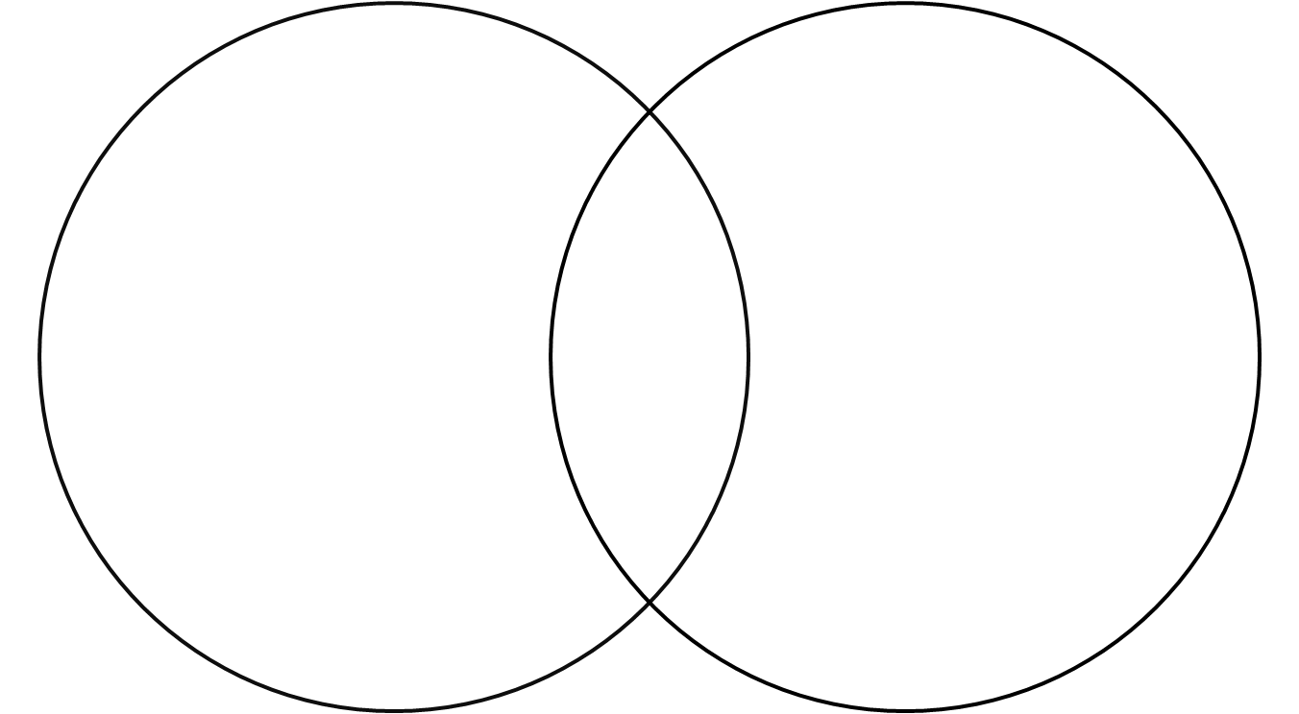
What’s Your Venn?
Please draw what your Venn between Math PBL and CCSS-M is and explain why.

Slide 9
ConnectEd’s PBL Math Curriculum
ConnectEd developed 10 pre-algebra and algebra project-based and problem-based units in order to support engineering pathway students in mathematics.

Slide 10
ConnectEd’s PBL Math Curriculum
  Currently our math curriculum is part of a rigorous randomized controlled trial through a federal i3 (Investing in Innovation) project in 17 districts across California that will impact approximately 6000 students with achievement on 8th grade CST Algebra scores as the measurement.

Slide 11
ConnectEd’s PBL Math Curriculum
Unit 1: Wind Power
Unit 3: People Movers
Measurement, fraction, and percent skills are applied to build the most efficient wind turbine possible
Graphs, algebraic expressions, and ratios are used to build and analyze a transportation system
Unit 2: Blueprints and Models
Unit 4: Safe Combinations
Exponent rules to calculate the number of
possible combinations on a constructed combination lock. Writing and solving equations are used to “code” and “decode” solutions
Scale, slope, and proportional reasoning are taught through the design of an access ramp and a remodeling plan for a building
Notes:
For Common Core Literacy, there are three shifts are at the heart of the Common Core: moving to content-rich informational text as a foundational source for building student knowledge, proving regular opportunities for students to engage with grade-appropriate increasingly complex text and the associated academic language, and finally common core positions evidence-based communication as central to the student learning experience.

Slide 12
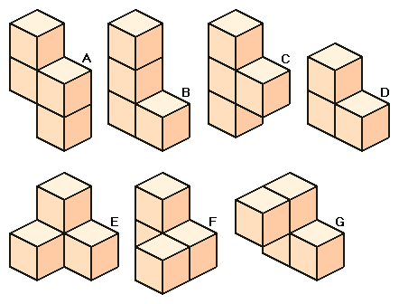
ConnectEd’s PBL Math Curriculum
Unit 1: Puzzle Cube
Unit 3: Catapult Game
Solve single-variable linear equations as students build the pieces of a puzzle cube
Solve quadratic equations to design and play a game with projectile machines
Unit 2: Air Traffic Control
Unit 6: Electrical Resistance
Graph linear equations to chart the progress of multiple planes and direct them to land safely
Solve rational expressions to calculate the total resistance in circuits
Notes:
For Common Core Literacy, there are three shifts are at the heart of the Common Core: moving to content-rich informational text as a foundational source for building student knowledge, proving regular opportunities for students to engage with grade-appropriate increasingly complex text and the associated academic language, and finally common core positions evidence-based communication as central to the student learning experience.

Slide 13
Experiential Project from “The Catapult Game”
Your group’s task is to use mathematics to determine how far away to place your catapult in order to hit the targets on a castle poster.
What mathematical content and practices are involved?
Materials: Catapult, Tape Measure, Grid Poster Paper (1”X1” squares), Markers, Laptops or graphing calculators

Slide 14
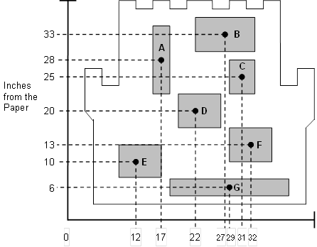
Experiential Project from “The Catapult Game”

Slide 15
Experiential Project from “The Catapult Game”

Slide 16
Where’s the Math?
Please discuss in your groups what mathematical content and practices were involved in this project. Be ready to share out.
Notes:
HS-LS2-7. Design, evaluate, and refine a solution for reducing the impacts of human activities on the enviro
nment and biodiversity.

Slide 17
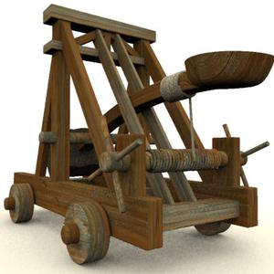
Catapult Game Unit Overview
The main mathematical concept of the Catapult Game unit focuses on connecting various aspects of quadratic functions (factoring, roots, x-intercepts, graphs, quadratic formula, applications).
We work to emphasize the meaning of these math concepts in CONTEXT!
Notes:
CA-HIST11-11.5 Trace the impact of, need for, and controversies associated with environmental conservation, expansion of the national park system, and the development of envi­ronmental protection laws, with particular attention to the interaction between environmental protection advocates and property rights advocates.
The National Environmental Policy Act (1969)
The Clean Air Act (1970)
The Clean Water Act (1972)
The Safe Drinking Water Act (1974)
The Comprehensive Environmental Response, Compensation and Liability Act (1980)
The Pollution Prevention Act (1990)

Slide 18
Lesson 1 Overview:
Multiplying Binomials and Finding Area
Students multiply binomials through an area model and find patterns in perfect square trinomials and difference of squares.
Notes:
CA-HIST11-11.5 Trace the impact of, need for, and controversies associated with environmental conservation, expansion of the national park system, and the development of envi­ronmental protection laws, with particular attention to the interaction between environmental protection advocates and property rights advocates.
The National Environmental Policy Act (1969)
The Clean Air Act (1970)
The Clean Water Act (1972)
The Safe Drinking Water Act (1974)
The Comprehensive Environmental Response, Compensation and Liability Act (1980)
The Pollution Prevention Act (1990)

Slide 19
Lesson 2 Overview:
Graphs of Equations in Factored Form
Notes:
CA-HIST11-11.5 Trace the impact of, need for, and controversies associated with environmental conservation, expansion of the national park system, and the development of envi­ronmental protection laws, with particular attention to the interaction between environmental protection advocates and property rights advocates.
The National Environmental Policy Act (1969)
The Clean Air Act (1970)
The Clean Water Act (1972)
The Safe Drinking Water Act (1974)
The Comprehensive Environmental Response, Compensation and Liability Act (1980)
The Pollution Prevention Act (1990)

Slide 20
Graphs of Equations in Factored Form
The x-intercepts or zeroes tell us about the graphs of quadratics in this context
The set of x-values that lead to positive areas is bound by the points where the function is equal to zero. We already know that these points are the roots or x‑intercepts of the function. They are also called the zeroes of the function.
Notes:
CA-HIST11-11.5 Trace the impact of, need for, and controversies associated with environmental conservation, expansion of the national park system, and the development of envi­ronmental protection laws, with particular attention to the interaction between environmental protection advocates and property rights advocates.
The National Environmental Policy Act (1969)
The Clean Air Act (1970)
The Clean Water Act (1972)
The Safe Drinking Water Act (1974)
The Comprehensive Environmental Response, Compensation and Liability Act (1980)
The Pollution Prevention Act (1990)

Slide 21
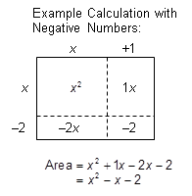
Lesson 3 Overview:
Factoring
Factoring using the area model
Notes:
CA-HIST11-11.5 Trace the impact of, need for, and controversies associated with environmental conservation, expansion of the national park system, and the development of envi­ronmental protection laws, with particular attention to the interaction between environmental protection advocates and property rights advocates.
The National Environmental Policy Act (1969)
The Clean Air Act (1970)
The Clean Water Act (1972)
The Safe Drinking Water Act (1974)
The Comprehensive Environmental Response, Compensation and Liability Act (1980)
The Pollution Prevention Act (1990)

Slide 22
Lesson 4.2
Factoring Doesn’t Always Work
(?, 25)
Notes:
CA-HIST11-11.5 Trace the impact of, need for, and controversies associated with environmental conservation, expansion of the national park system, and the development of envi­ronmental protection laws, with particular attention to the interaction between environmental protection advocates and property rights advocates.
The National Environmental Policy Act (1969)
The Clean Air Act (1970)
The Clean Water Act (1972)
The Safe Drinking Water Act (1974)
The Comprehensive Environmental Response, Compensation and Liability Act (1980)
The Pollution Prevention Act (1990)

Slide 23

Lesson 4.2
Factoring Doesn’t Always Work
Notes:
CA-HIST11-11.5 Trace the impact of, need for, and controversies associated with environmental conservation, expansion of the national park system, and the development of envi­ronmental protection laws, with particular attention to the interaction between environmental protection advocates and property rights advocates.
The National Environmental Policy Act (1969)
The Clean Air Act (1970)
The Clean Water Act (1972)
The Safe Drinking Water Act (1974)
The Comprehensive Environmental Response, Compensation and Liability Act (1980)
The Pollution Prevention Act (1990)

Slide 24
Lessons 4.4
Analyze the Catapult Part 2
    Determine where to place each catapult in order to hit all of the targets on the castle.
 | Must Place Catapult This Distance Away from Castle to Hit the Target (ft.) (Round all answers to the nearest hundredth place)
Target | Catapult Q |  | Catapult R |  | Catapult S
 | Ammunition | Supplies | Ammunition | Supplies | Ammunition | Supplies
A | Impossible; no real solutions | 2, 11 | 1.63, 15.73 | 3.21, 7.79 | 4, 6 | Impossible; no real solutions
Notes:
CA-HIST11-11.5 Trace the impact of, need for, and controversies associated with environmental conservation, expansion of the national park system, and the development of envi­ronmental protection laws, with particular attention to the interaction between environmental protection advocates and property rights advocates.
The National Environmental Policy Act (1969)
The Clean Air Act (1970)
The Clean Water Act (1972)
The Safe Drinking Water Act (1974)
The Comprehensive Environmental Response, Compensation and Liability Act (1980)
The Pollution Prevention Act (1990)

Slide 25
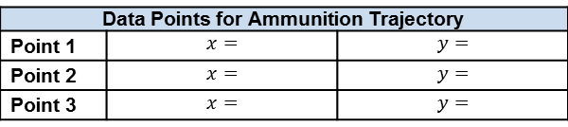
Lesson 5
Playing the Catapult Game Virtually
Go to http://www.8kindsoffun.com/Catapult/CatapultGUI.html and record your calculations for playing the virtual catapult game below.
An example of a quadratic regression applet can be found at
http://www.xuru.org/rt/PR.asp
Data Points for Ammunition Trajectory
Point 1 | $$x=$$ | $$y=$$
Point 2 | $$x=$$ | $$y=$$
Point 3 | $$x=$$ | $$y=$$
Notes:
CA-HIST11-11.5 Trace the impact of, need for, and controversies associated with environmental conservation, expansion of the national park system, and the development of envi­ronmental protection laws, with particular attention to the interaction between environmental protection advocates and property rights advocates.
The National Environmental Policy Act (1969)
The Clean Air Act (1970)
The Clean Water Act (1972)
The Safe Drinking Water Act (1974)
The Comprehensive Environmental Response, Compensation and Liability Act (1980)
The Pollution Prevention Act (1990)

Slide 26
Standards of Mathematical Practice
What standards of mathematical practice from the CCSS-M did you find in the project?
1. Make sense of problems and persevere in solving them.
2. Reason abstractly and quantitatively.
3. Construct viable arguments and critique the reasoning of others.
4. Model with mathematics.
5. Use appropriate tools strategically.
6. Attend to precision.
7. Look for and make use of structure.
8. Look for and express regularity in repeated reasoning.
Notes:
CA-HIST11-11.5 Trace the impact of, need for, and controversies associated with environmental conservation, expansion of the national park system, and the development of envi­ronmental protection laws, with particular attention to the interaction between environmental protection advocates and property rights advocates.
The National Environmental Policy Act (1969)
The Clean Air Act (1970)
The Clean Water Act (1972)
The Safe Drinking Water Act (1974)
The Comprehensive Environmental Response, Compensation and Liability Act (1980)
The Pollution Prevention Act (1990)

Slide 27
Has Your Venn Changed?
Take a look at your Venn from the beginning of the session.
Has your Venn changed at all?
How so?
Notes:
CA-HIST11-11.5 Trace the impact of, need for, and controversies associated with environmental conservation, expansion of the national park system, and the development of envi­ronmental protection laws, with particular attention to the interaction between environmental protection advocates and property rights advocates.
The National Environmental Policy Act (1969)
The Clean Air Act (1970)
The Clean Water Act (1972)
The Safe Drinking Water Act (1974)
The Comprehensive Environmental Response, Compensation and Liability Act (1980)
The Pollution Prevention Act (1990)

Slide 28

www.ConnectEdCalifornia.org
kiwasaki@connectedcalifornia.org
psunho@connectedcalifornia.org
Notes:
Visit us online today at www.ConnectEdCalifornia.org

